Slide 1


Project Scope Management
1

Slide 2




Why Do We manage scope?
Table of content
Survey
Case study of failed project
PMI report on Scope management
What Is Scope Management?
Scope Management Overview
Project Scope and Product Scope
How Do We Manage Scope?
Plan Scope Management
Collect Requirement
Define Scope
Create WBS
Validate Scope
Control Scope
Scope Management In Agile
Summary

Slide 3



WHY DO MANAGE SCOPE?

Slide 4
Survey
What do you think about “Scope”?
What is challenge in your project about scope?
What do you expect from this course?

Slide 5
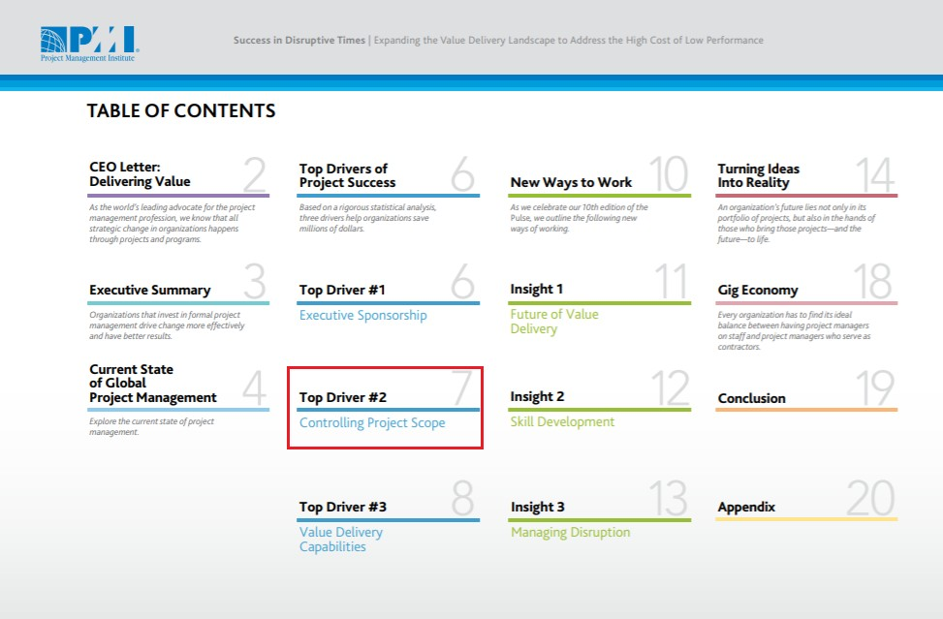
What does PMI say

Slide 6
WHAT IS SCOPE MANAGEMENT?

Slide 7

Scope Management Overview
Project Scope Management includes the processes required to ensure that the project includes ALL the work required, and ONLY the work required to complete the project successfully.
Scope including: Project scope and
Product scope

Slide 8
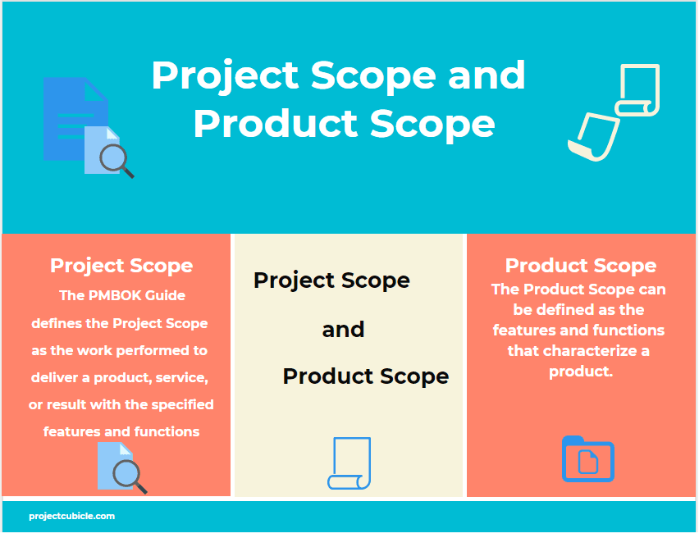
Scope Management Overview

Slide 9
HOW DO WE MANAGE SCOPE?

Slide 10
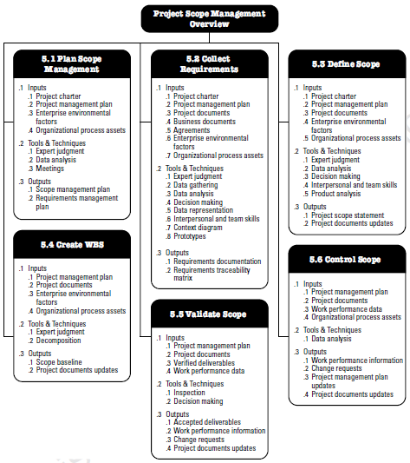
Scope Management Processes

Slide 11
Plan Scope Management
Document how the project and product scope will be defined, validated, and
controlled.
INPUTS
TOOLS & TECHNIQUES
OUTPUTS
Project Management Plan.
EEF & OPA (qms, pmc,
pmc 360…)
Expert judgement
Meeting
Scope Management Plan.
Requirement Management
Plan.

Slide 12
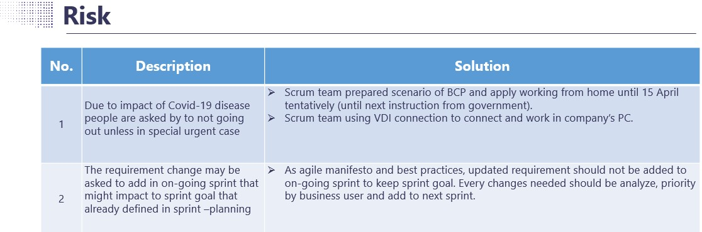
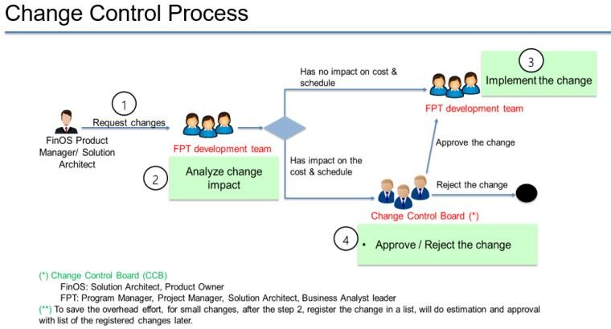
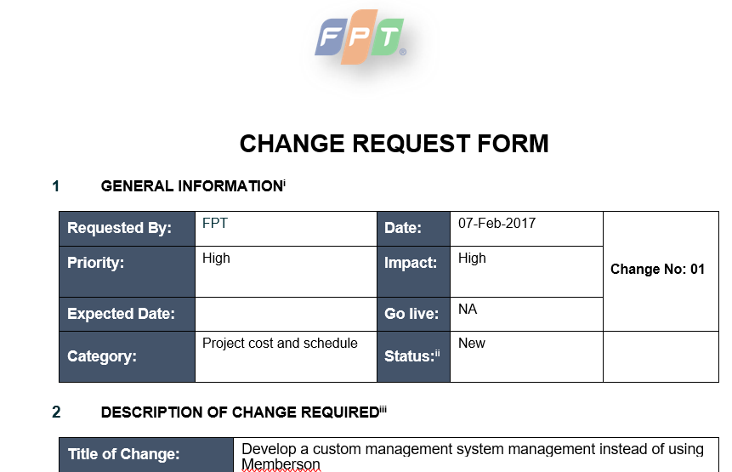
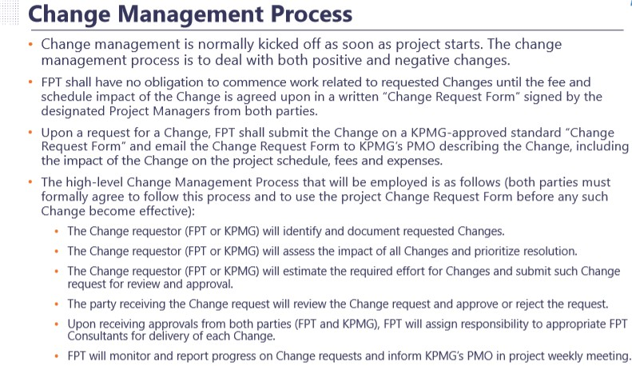
Plan Scope Management

Slide 13
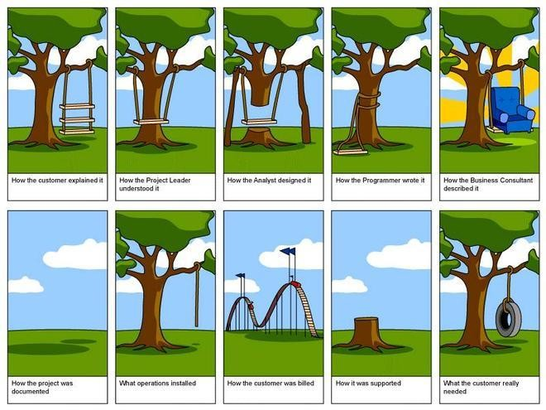
Collect Requirement

Slide 14
Collect Requirement
Determining, document, and manage stakeholder needs and requirements to meet
project objectives
INPUTS
TOOLS & TECHNIQUES
OUTPUTS
Project charter
Business document
Brainstorming
Interview
Wire frame/ prototyping
Focus group
Requirement
Documentation
Requirement Management
Plan
Requirement Traceability Matrix

Slide 15
Quiz 1
Currently, there are cases where expenses claims can’t be performed via the available channels
as current system have limited approval workflow.
As such, staff has resorted to the use of hardcopy payment voucher to address this issue. However, there may be bottleneck at different approval stages which lead to delay in payment processing.
Arising from this, Finance department of X company has requested for an online payment voucher platform to promote better efficiency in approval and payment processing while reducing the use of hardcopy papers.
Request:
Let’s brainstorming with your group to list down all questions (as much as possible) to collect
requirement from users

Slide 16

Define Scope
Develop a detailed description of the project and product
INPUTS
TOOLS & TECHNIQUES
OUTPUTS
Requirements Documentation
OPA
Product analysis
Expert judgement
Project Scope Statement
In Scope
Out scope
Constraints & Assumptions

Slide 17

Create WBS
Subdivide project deliverables and project work into smaller, more manageable
components
INPUTS
TOOLS & TECHNIQUES
OUTPUTS
Project Scope Statement
Requirements
Documentation
Organizational process
assets
Expert judgement
Decomposition
Scope Baseline (WBS, WBS Dictionary, project scope statement)

Slide 18
Validate Scope
Formalize acceptance of the completed project deliverables
INPUTS
TOOLS & TECHNIQUES
OUTPUTS
Project Management Plan
Requirements
Documentation
Validated Deliverables
Inspection
Decision making
Accepted Deliverable
Change Request

Slide 19
Control Scope
Monitor the status of the project and product scope and manage changes to scope
baseline
INPUTS
TOOLS & TECHNIQUES
OUTPUTS
Project Management Plan
Requirements
Documentation
Requirements Traceability
Matrix
Organizational process
assets
Meeting
Data analysis
Work Performance
Measurements
Change Requests

Slide 20
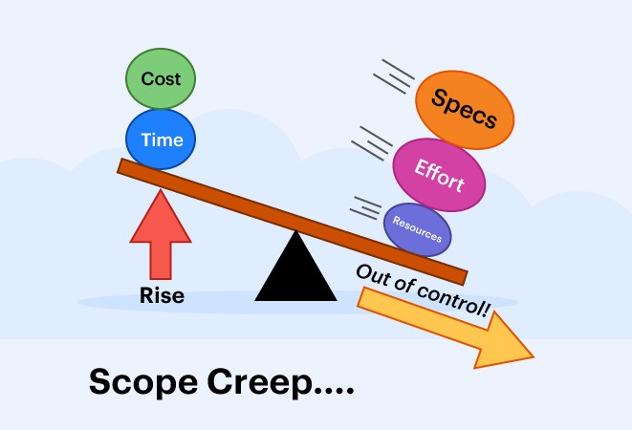

Scope Creep
The uncontrolled expansion to product or project scope without adjustments
to time, cost, and resources.

Slide 21


Gold Plating
Gold plating is giving the customer something that they did not ask for, something that wasn’t scoped, and often something that the they may not need.

Slide 22
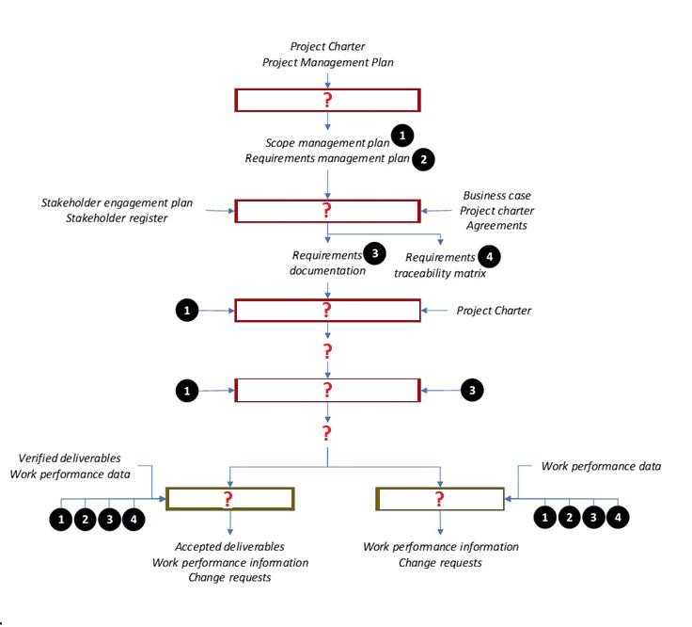
Quiz 2
15

Slide 23
SCOPE MANAGEMENT IN AGILE

Slide 24
Consideration for Agile model
Rolling wave planning
Scope is approved before sprint start
DOR and DOD
Responding to change
Best applied in Product development, R&D
Agile fixed price project (ref.)?

Slide 25
SUMMARY

Slide 26
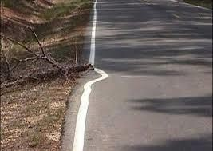
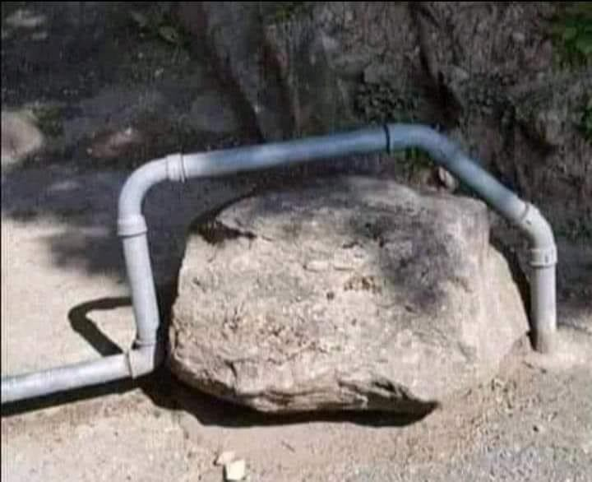
Thinking
18

Slide 27








Summary
Define clear In/Out Scope and Assumption
Do not accept ambiguous requirement
Say “NO” when needed
Define and get agreement on
change control process
Review scope regularly (weekly
basis recommended)
Give and take mindset
28

